Slide 1


Data Analysis on Online Retail Dataset using Apriori and segmentation using RFM model and k-means clustering
A Mahikanth Reddy (W9332307)
Kalyana Ramachandra Reddy Karri(W9316286 )
Manjunath Chandrakanth Yalala (W9290876)
Preetham Chikkamagalur Shylendhra (W9300889 )

Slide 2
Objectives
Perform statistical analysis on the dataset
Identify customer buying behaviours
Improve the quality of service
Discover customer shopping patterns and trends
Achieve better customer satisfaction and retention
Design effective marketing strategy targeting specific customers

Slide 3
Introduction
A case study has been conducted on a retail data set which sells gift products across multiple countries
The data set contains different variables such as name of the product, customer Id, unit price, country, quantity, stock code, invoice date, etc.
Two approaches have been identified to meet the objectives: Apriori and K means
Descriptive questions are studied and Predictive questions are researched
Useful insights discovered will be displayed in this presentation

Slide 4
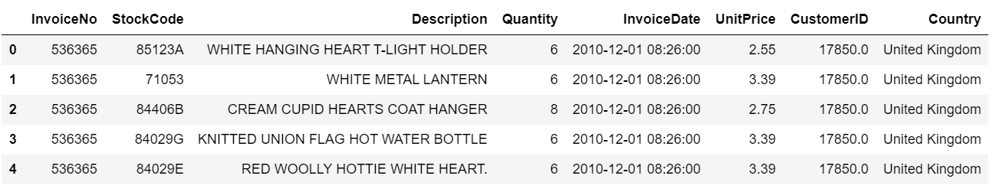
Dataset Overview

Slide 5
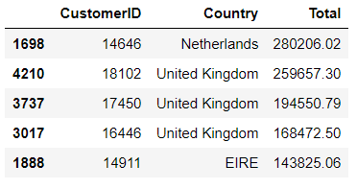
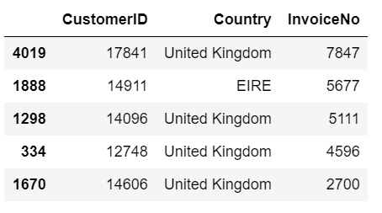
Data Analysis
Top 5 customers with highest spending
Number of orders by each customer

Slide 6
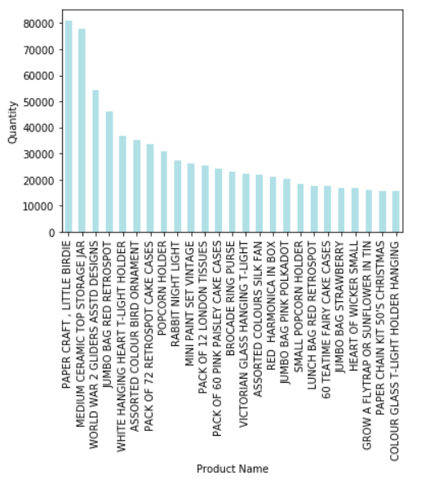
Top 25 most brought products

Slide 7
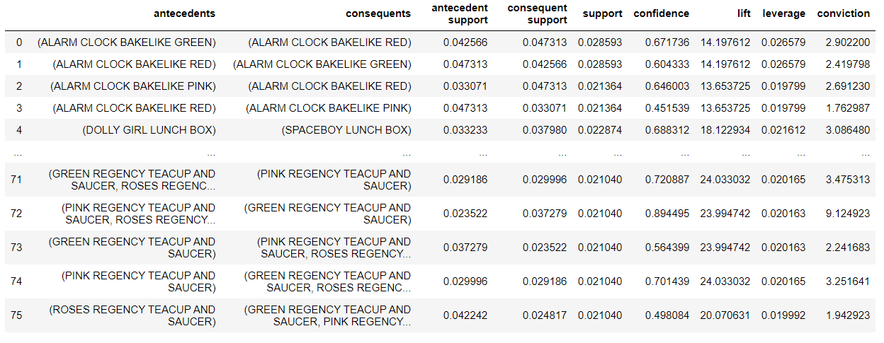
Apriori Algorithm
Apriori algorithm is used for mining frequent itemset and relevant association rules. It is devised to operate on a database containing a lot of transactions, for instance, items bought by customers in an online store
It is very important for effective Market Basket Analysis and it helps the customers in purchasing their items with more ease which increases the sales of the markets

Slide 8
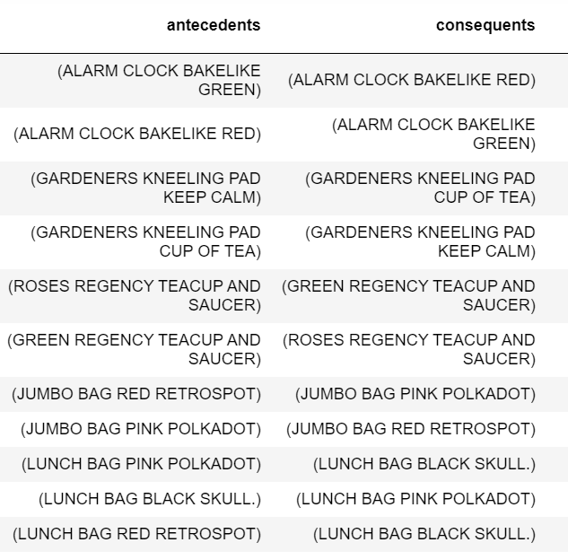
Apriori Algorithm applied for UNITED KINGDOM
UK Based company
Maximum orders
Highest in the total Revenue generated

Slide 9
Apriori helped us in understanding patters which connected items.
One itemset two itemset and three itemset
From Analytics part, itemset for
  Peak Month
  Peak week
  Different countries and their peak months
Everything helped in understanding customers buying patterns over a year in different countries.

Slide 10
RFM model k-means clustering
Clustering is defined as the task of identifying subgroups in the data such that data points in the same subgroup (cluster) are very similar while data points in different clusters are very different
RFM (Recency, Frequency, Monetary) analysis is a method to identify high-response customers in marketing promotions, and to improve overall response rates

Slide 11
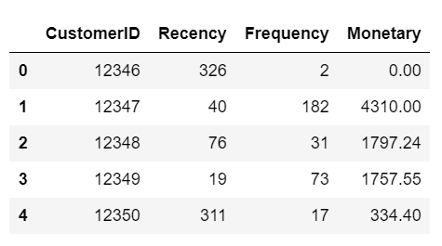
Recency, Frequency, Monetary

Slide 12
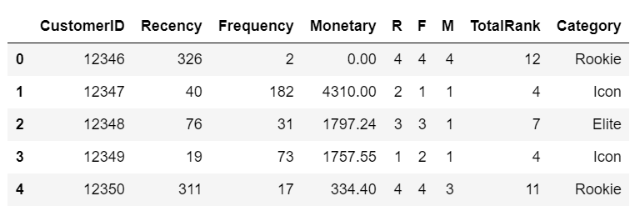
Giving Category names and assigning values to clusters
Next, Normalization of R F and M values
Identification of K value using Elbow curve method

Slide 13
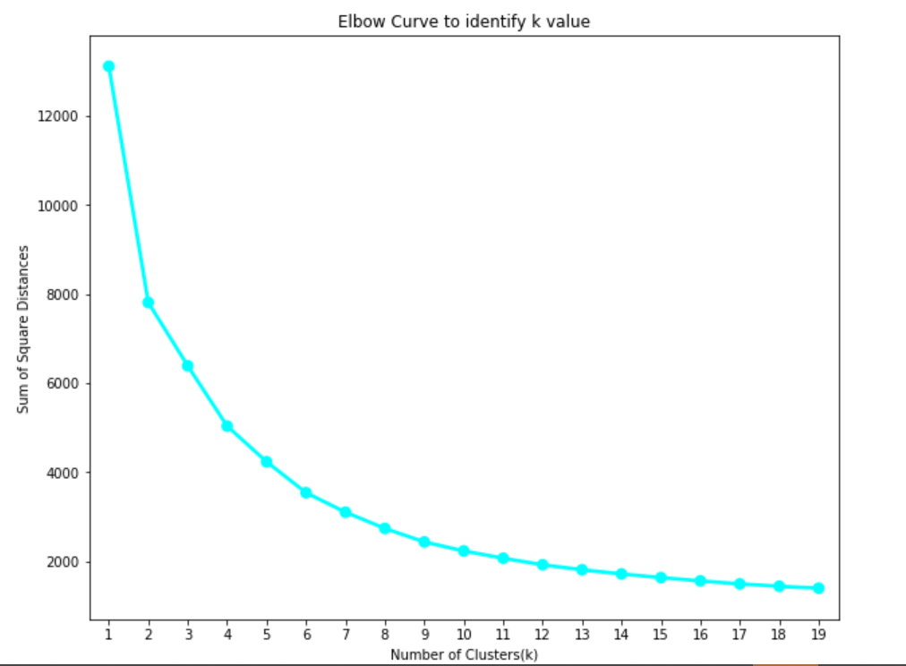
Identification of K value using Elbow curve method

Slide 14
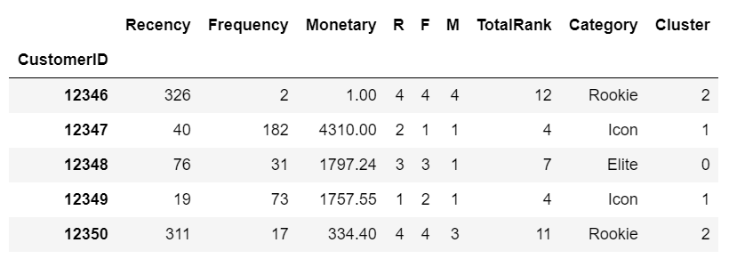
Giving cluster labels
Rookie and Select clubbed to cluster 2

Slide 15
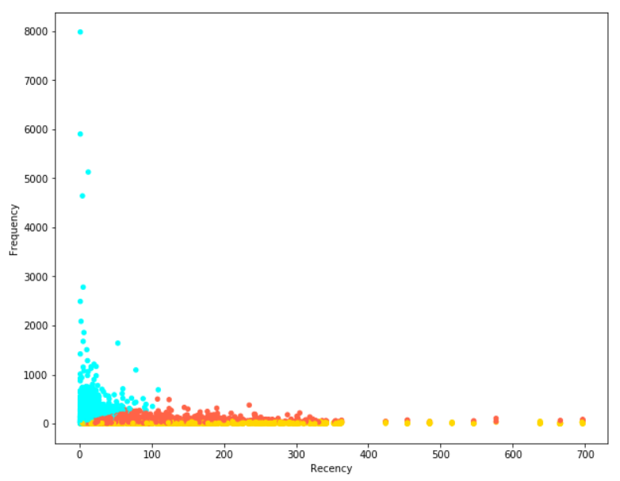
Plotting the clusters(matplotlib)

Slide 16
Results and Discussion
What are the peak and least hours of sales?
The peak hours of sale are observed between 12 and 2 in the noon and drops to lowest after 6 till 8 in the evening.
Which day in the week contributes to the highest and lowest sales?
Thursday has shown the highest amount of sales and Sunday notably has the least sales among all days.
What months of the year reflect the highest sales and lowest sales?
November ,October and September highest. The months with the lowest sale are February and April.

Slide 17
Which product is getting sold the most?
Which countries have spent the most money on orders?
Which countries have ordered the most and the least?
Which products/items have customers purchased together often?
Can the customers be segmented based on their importance to the business?
Can the customers be segmented based on their recency, frequency, and monetary factors?
Who are the most and least valuable customers to the business?
Which types of customers are more likely to respond to a certain marketing strategy?
Which products are well performers common to all the countries?

Slide 18
Conclusion
The approaches used in this project has enabled us to understand the data thoroughly and we’ve been able to extract valuable insights from the dataset. The process involved using multiple libraries in the code which are necessary for the algorithm. Apriori and K-means Clustering was methodically implemented on the cleansed and formatted dataset. Using this, retailers can understand how to manage their stocks, organize things and plan marketing strategies to enhance their trade

Slide 19
THANK YOU

